Slide 1
PROJECT 243-RESUME CLASSIFICATION
BUSINESS OBJECTIVE: The document classification solution should significantly reduce the manual human effort in the HRM. It should achieve a higher level of accuracy and automation with minimal human intervention
SAMPLE DATASET DETAILS: Resumes and financial documents.
ACCEPTANCE CRITERIA: To build the best model which gives the maximum performance, and need to deploy the model with either RShiny or Flask/ stream lit
GROUP 2
TEAM MEMBERS:
Mr. ATHARVA JOSHI
Ms. KRISHNAVENI KOLIPAKA
Mr. SAGAR SRINIVAS
Mr. SOMASEKHAR REDDY G
Mr SUDARSHAN BANE
Ms. VAISHNAVI SHINDE

Slide 2
STEPS TAKEN TOWARDS MAKING THE PROJECT
EXTRACTING RESUMES
Converted the files from .doc, .docx, pdf to CSV.
Checked the number of resumes in each category.
2. EXPLORATORY DATA ANALYSIS(EDA)
Cleaned the data by removing stopwords, urls, and replaced bullet marks with spacing.
Performed tokenization and applied count vectorization to get the key skills present in each category.
Created wordclouds of individual categories to highlight the key skills.
Calculated the average years of experience required for each category.
3. MODEL BUILDING
Split the data into training and testing.
Built 6 different models and checked each models train and test accuracy.
Compared the training and testing accuracy of all the models.
Finalised the model which was performing best.

Slide 3
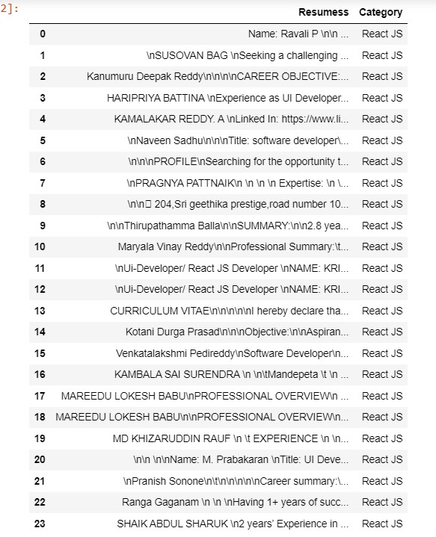
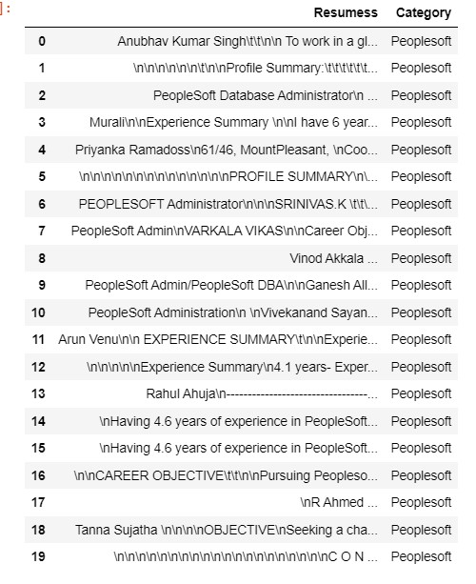
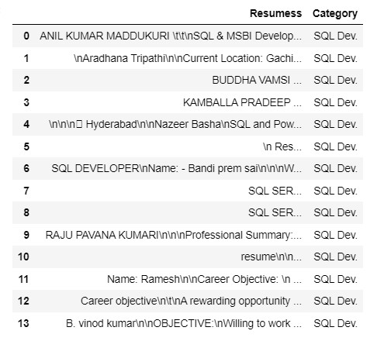
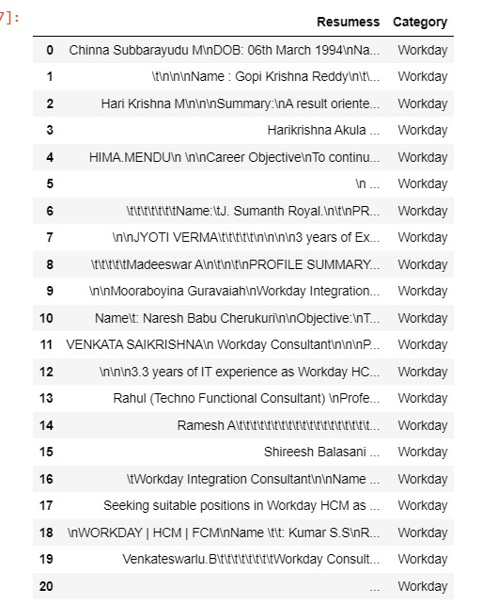
EXTRACTING RESUMES
Since there were 4 categories of resumes [ReactJS, SQL Dev., Workday, Peoplesoft] we extracted them individually.
The resumes were in .doc, .docx and pdf format.
We converted them to CSV to extract the files.
After extracting the files we created a new column to mention the resume category.

Slide 4
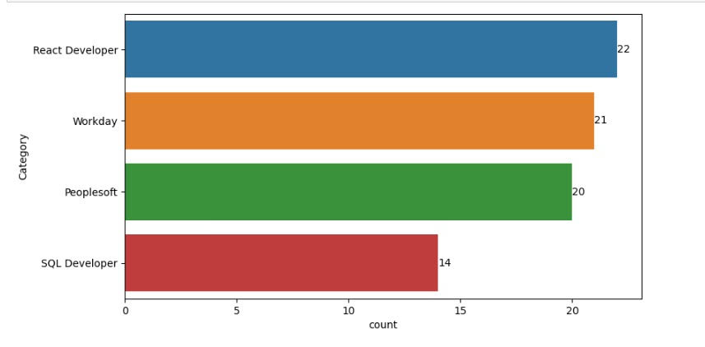
From the visualisation below we understand the number of resumes in each category.

Slide 5
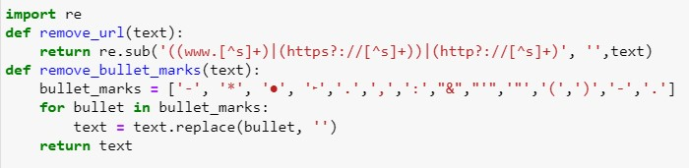
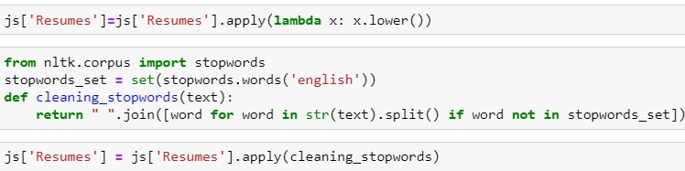
EXPLORATORY DATA ANALYSIS(EDA)
Removed any links present in the resumes.
Removed bullet marks.
Replaced it with space.
4. Converted it to lower case.
5. Removed stopwords.
These above tasks were performed on all the 4 categories

Slide 6
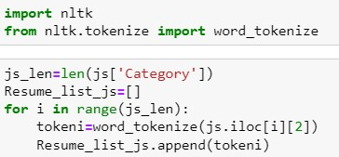
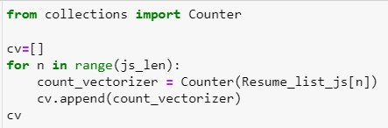
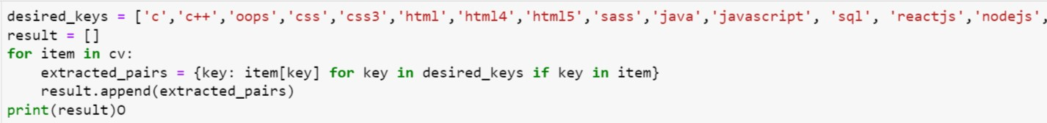
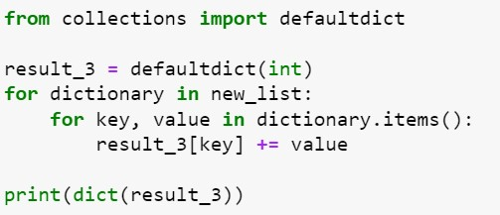
Performed tokenization
Applied count vectorization
Extracted specific key-value pairs using a loop
Calculated the most important skills

Slide 7
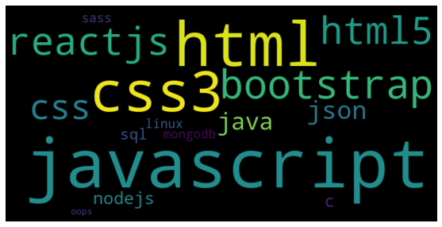
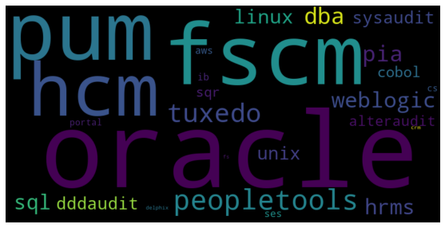
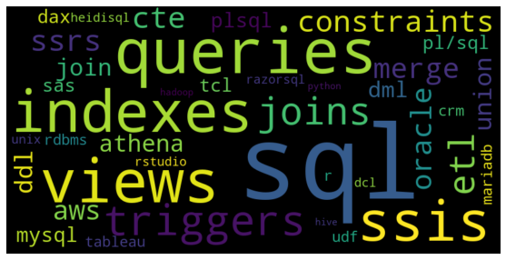
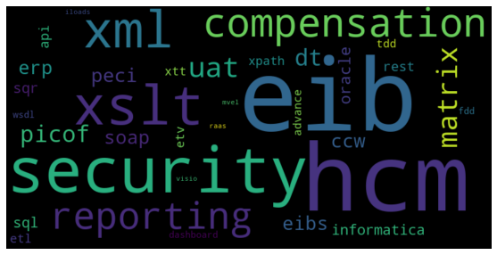
WORDCLOUD CONSISTING OF THE MOST IMPORTANT SKILLS
1. React JS
2. Peoplesoft
3. SQL Developer
4. Workday

Slide 8
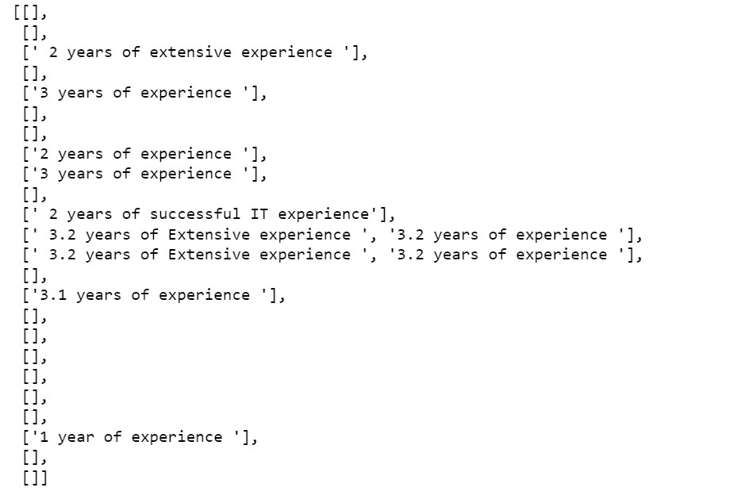
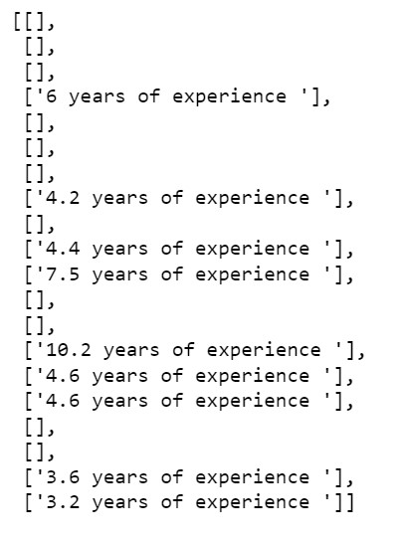
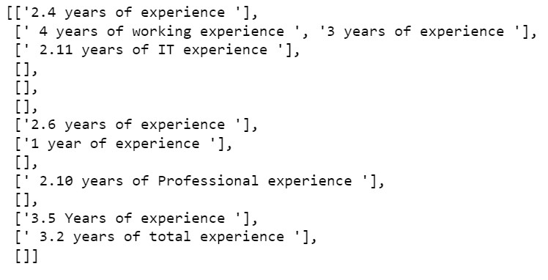
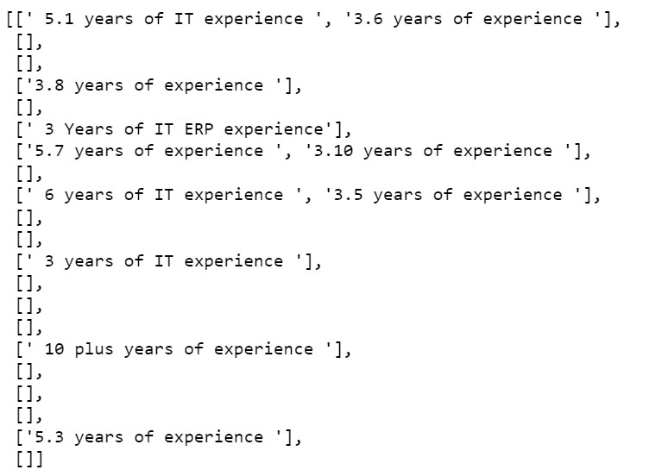
Average years of experience
Average work experience for React JS is between 2-3 years.
Average work experience for Peoplesoft is between 3-6 years.
Average work experience for SQL Developer is between 2-4 years.
Average work experience for Workday is between 3-6 years.

Slide 9
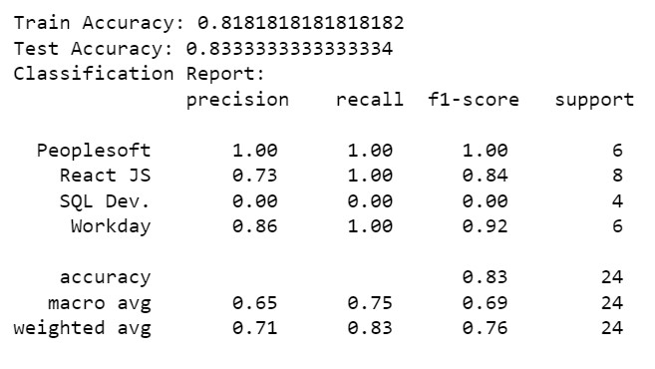
MODEL BUILDING
1. NAÏVE BAYES CLASSIFIER (USING REGULARIZATION PARAMETER)
The model achieved an overall accuracy of 83.33% on the test data, indicating reasonably accurate predictions for the resume categories. However, it exhibited poor performance in predicting the "SQL Dev." category, with precision and recall scores of 0.00.

Slide 10
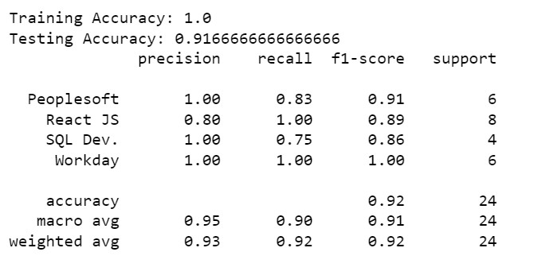
2. AdaBoost CLASSIFIER
From AdaBoost classifier we come to know that while training accuracy is 100%, the testing accuracy is slightly lower at 91.67%. This suggests that the model may be overfitting to some extent.

Slide 11
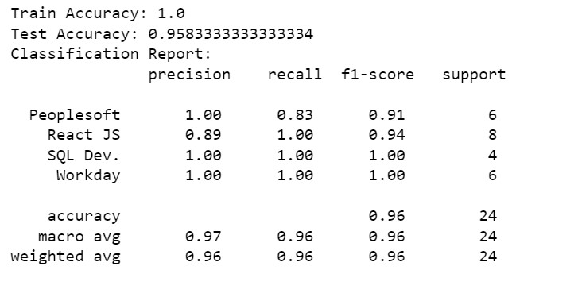
3. SUPPORT VECTOR MACHINE CLASSIFIER (SVM)
SVM model is achieving 100% accuracy on the training data but lower accuracy on the testing data, it indicates overfitting and lack of generalization. In such cases, deploying the model directly may not be ideal as it may not perform well on unseen data.

Slide 12
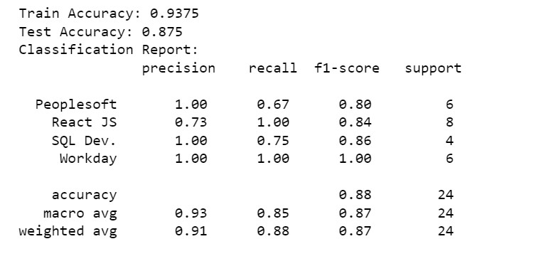
4. RANDOM FOREST CLASSIFIER
Overall, the model demonstrates good performance with high precision, recall, and F1-scores for most categories. This indicates its ability to accurately classify resumes into different categories. Considering the relatively high accuracy and balanced performance across categories, the model shows promise for deployment in real-world scenarios. However, it is always important to thoroughly evaluate the model's performance on various metrics and consider specific deployment requirements before making a final decision.

Slide 13
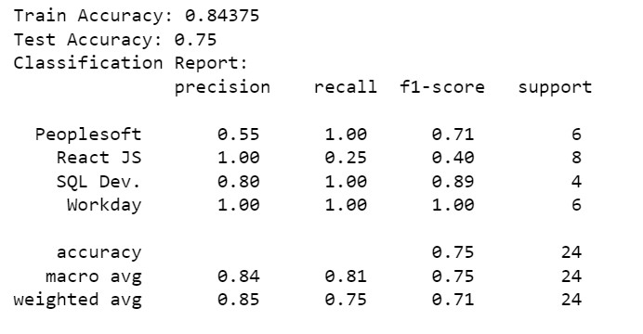
5. K-NEIGHBOURS CLASSIFIER
The k-neighbour model achieved a training accuracy of 84.38% and a testing accuracy of 75%. The lower testing accuracy compared to the training accuracy suggests that the model may be overfitting to some extent.

Slide 14
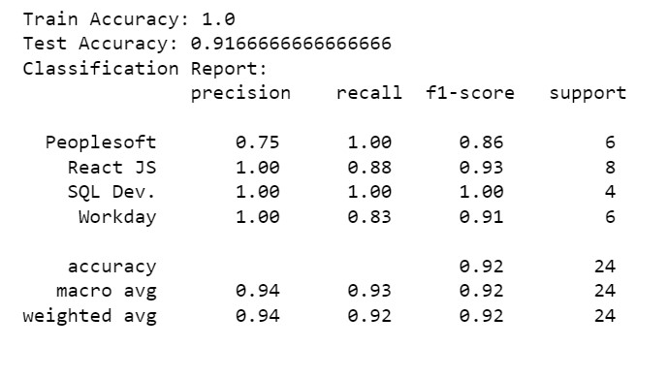
6. GRADIENT BOOSTING CLASSIFIER
The Gradient Boost Classifier achieved a perfect training accuracy of 100% and a testing accuracy of 91.67%. The high training accuracy suggests that the model may be overfitting to some extent, as it is able to perfectly fit the training data. However, the testing accuracy is slightly lower, indicating that the model's performance on unseen data is slightly reduced.

Slide 15
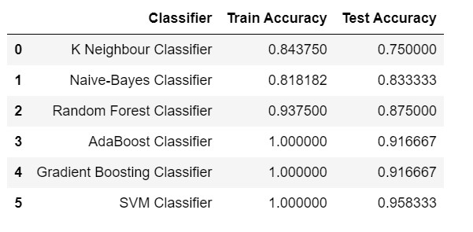
COMPARING ACCURACY OF DIFFERENT MODELS
Based upon the comparisons we chose Random Forest as our final model
REASONS WHY RANDOM FOREST PERFORMS BETTER:
Ensemble of Decision Trees: Random Forest is an ensemble learning technique that combines multiple decision trees. The ensemble approach helps to reduce overfitting and improve generalization by aggregating the predictions of multiple trees.
Robustness to Noise and Outliers: Random Forests are known for their robustness to noisy and outlier data. They can handle irrelevant features and noisy samples effectively, making them suitable for datasets with diverse or noisy data.
Feature Importance: Random Forests provide a measure of feature importance, which allows us to identify the most informative features in the dataset. This can be helpful for feature selection and gaining insights into the underlying patterns in the data.
Capturing Non-linearity and Interaction Effects: Random Forests can capture non-linear relationships and interaction effects between features. They are capable of learning complex decision boundaries, which makes them suitable for datasets with intricate patterns.
Less Sensitivity to Hyperparameters: Random Forests are generally less sensitive to the choice of hyperparameters compared to other models like k-nearest neighbors, boosting, or support vector machines. They often perform well with default parameter settings, reducing the need for extensive hyperparameter tuning.

Slide 16
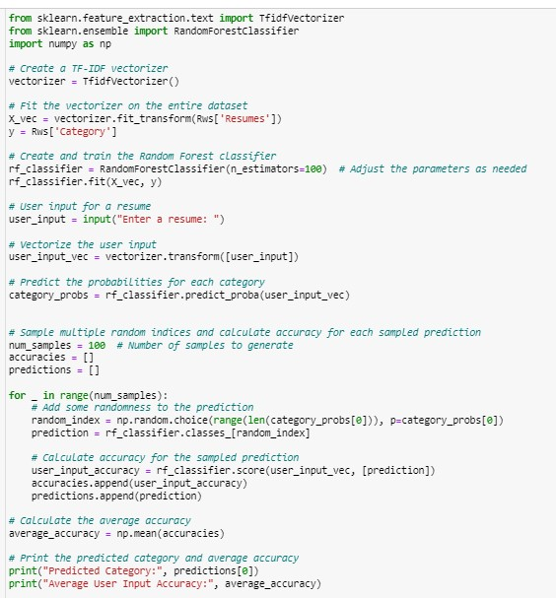
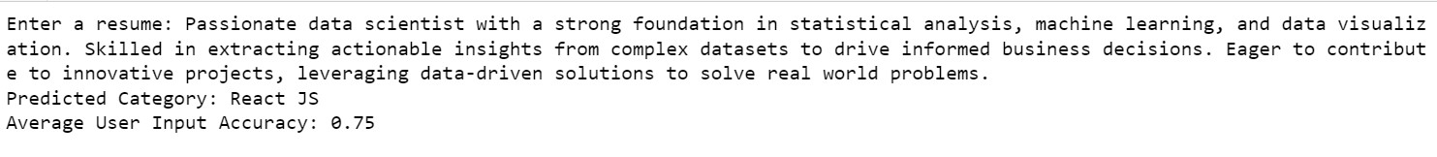
Checking accuracy through user input using Random Forest

Slide 17
Deployment
Random Forest Classification

Slide 18
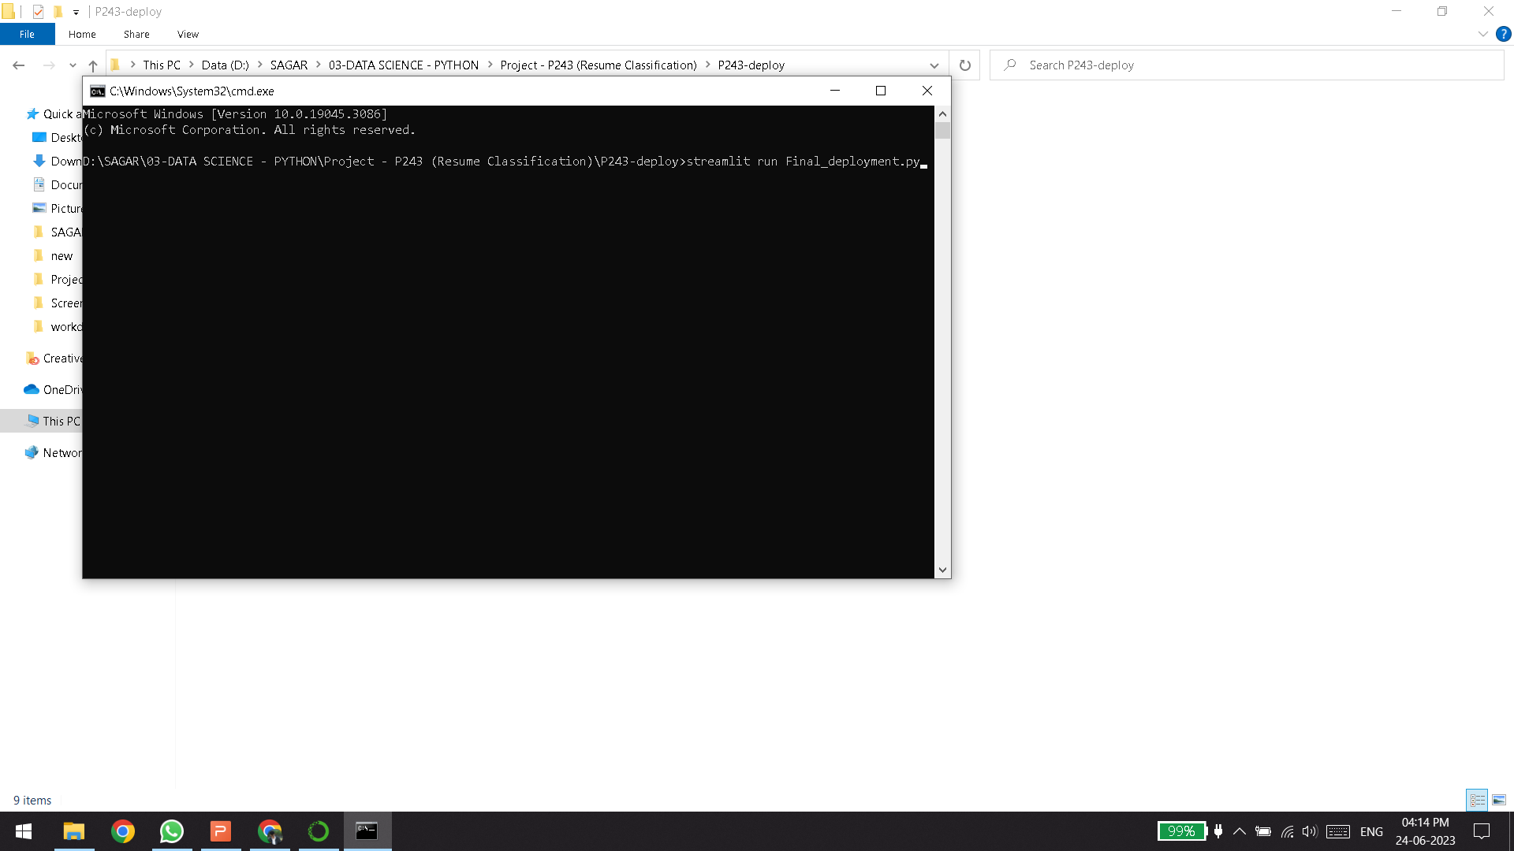
INITIALISING LOCAL DEPLOYMENT USING STREAMLIT

Slide 19
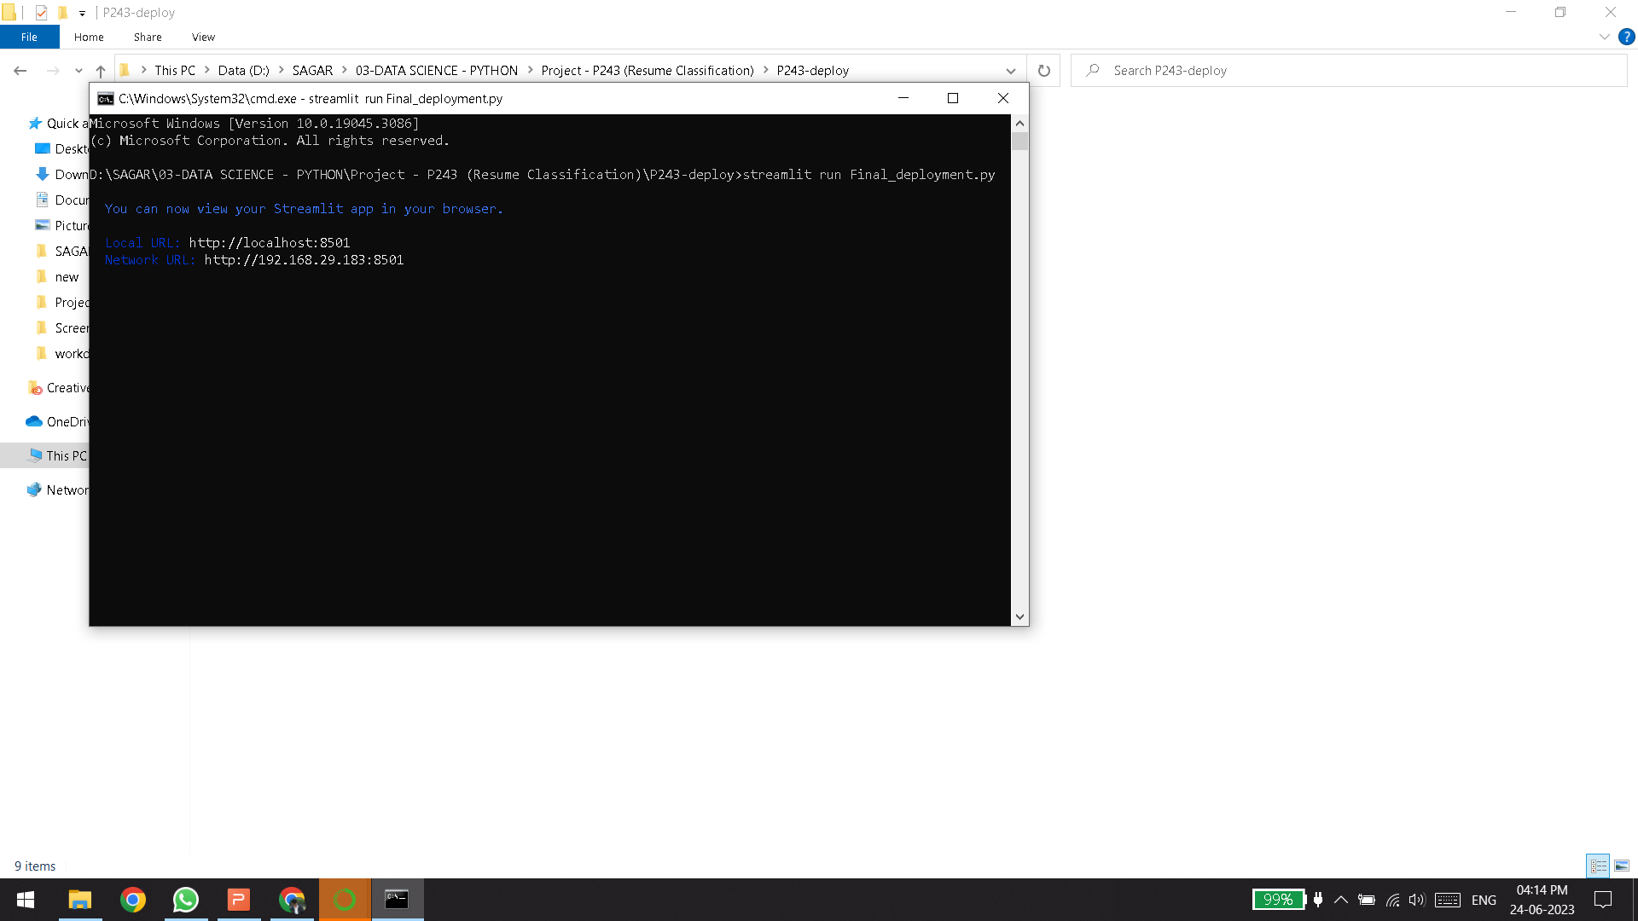
INITIALISING LOCAL DEPLOYMENT USING STREAMLIT

Slide 20
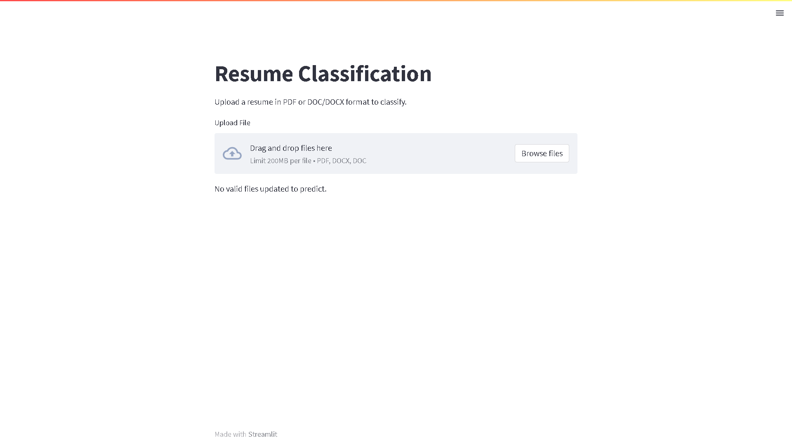
APPLICATION PAGE

Slide 21
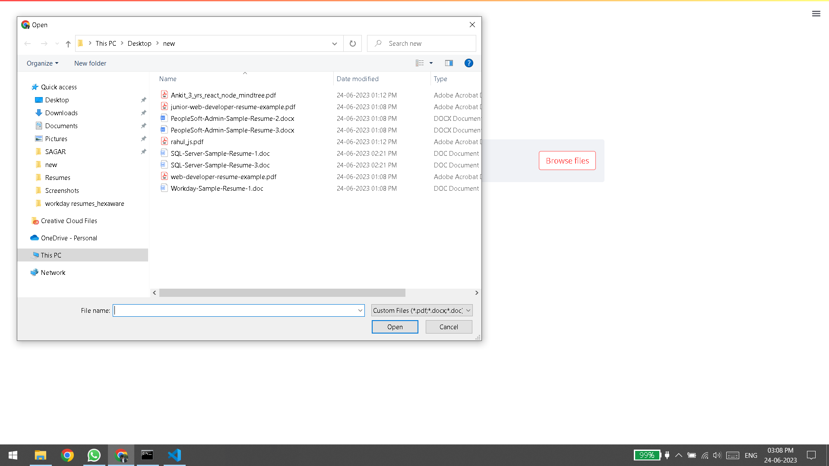
UPLOADING NEW SET OF RESUMES

Slide 22
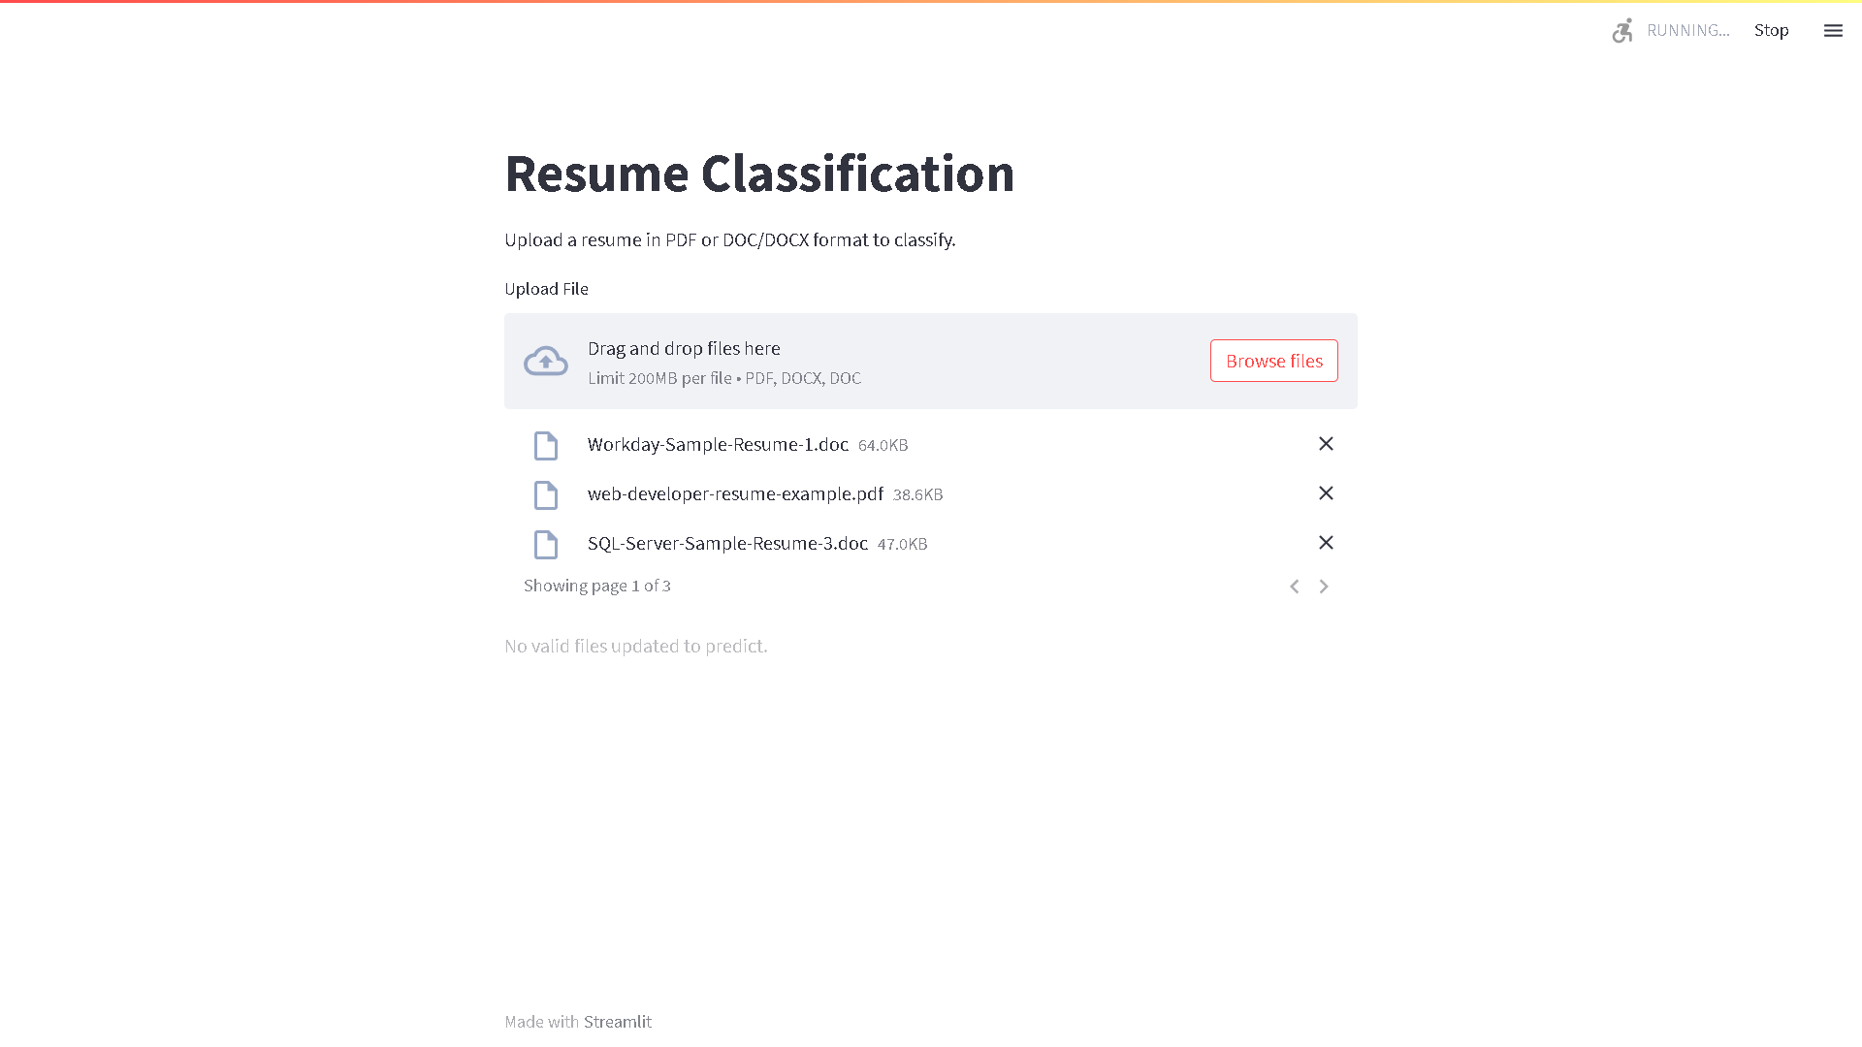
MAKING PREDICTION USING NEW SET OF RESUMES

Slide 23
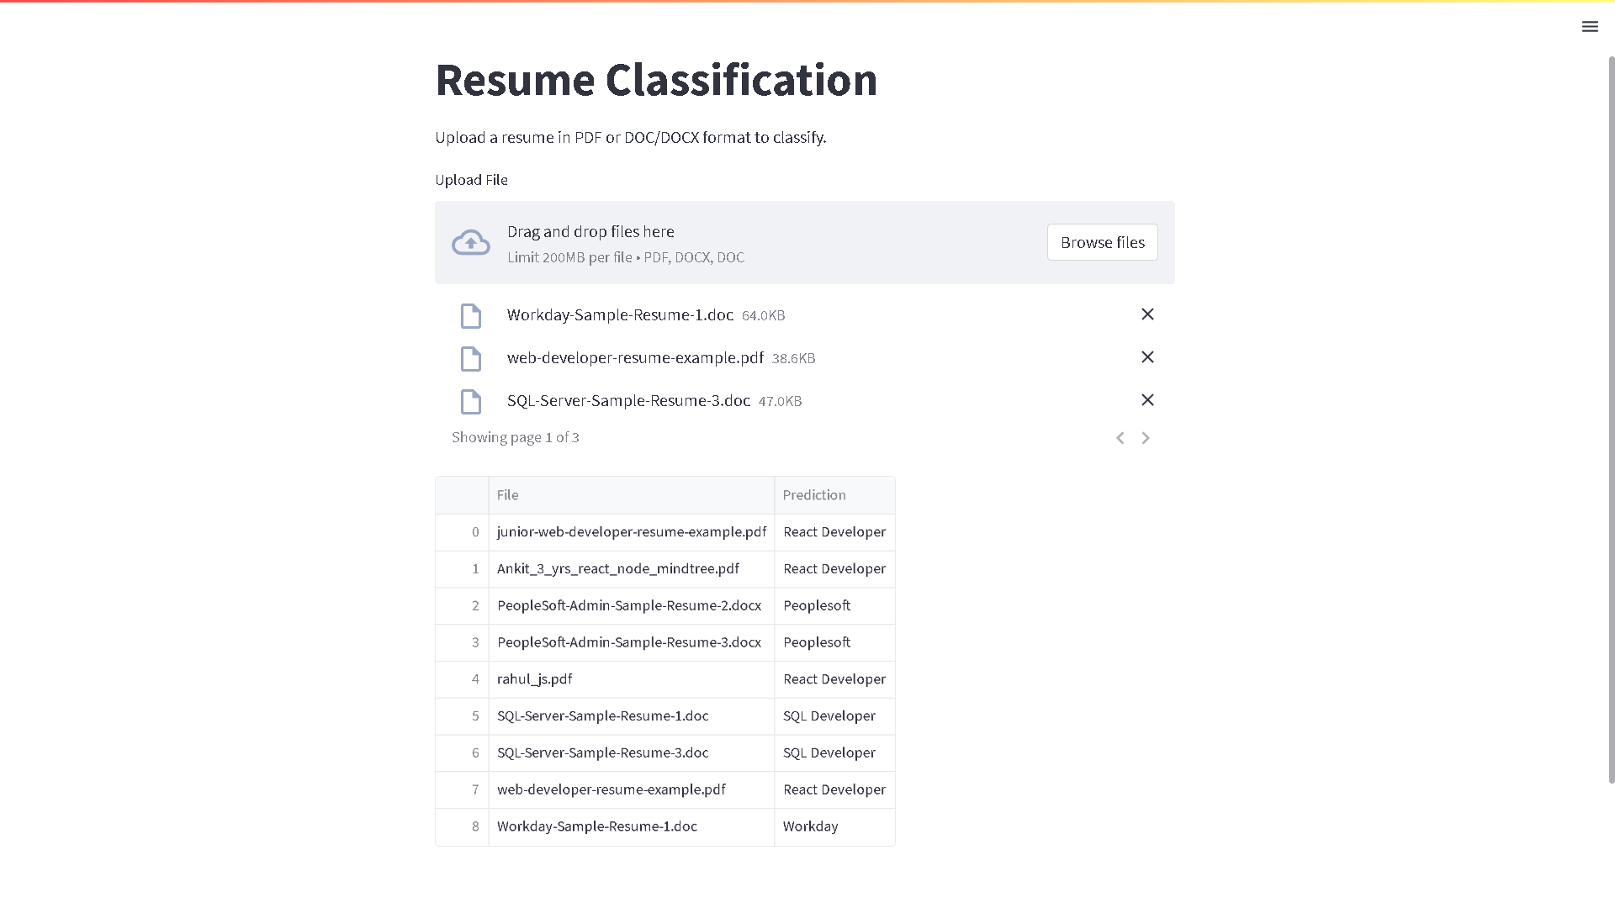
NEW RESUME - PREDICTION RESULTS

Slide 24
THANK YOU

